Slide 1




The Need for Marine Sensing
Modelling the impacts of climate change on finfish in the Irish Sea
STREAM Workshop – Swansea 4 May 2023
Prof. Carlos Garcia de Leaniz
Centre for Sustainable Aquatic Research (CSAR)
Swansea University

Slide 2
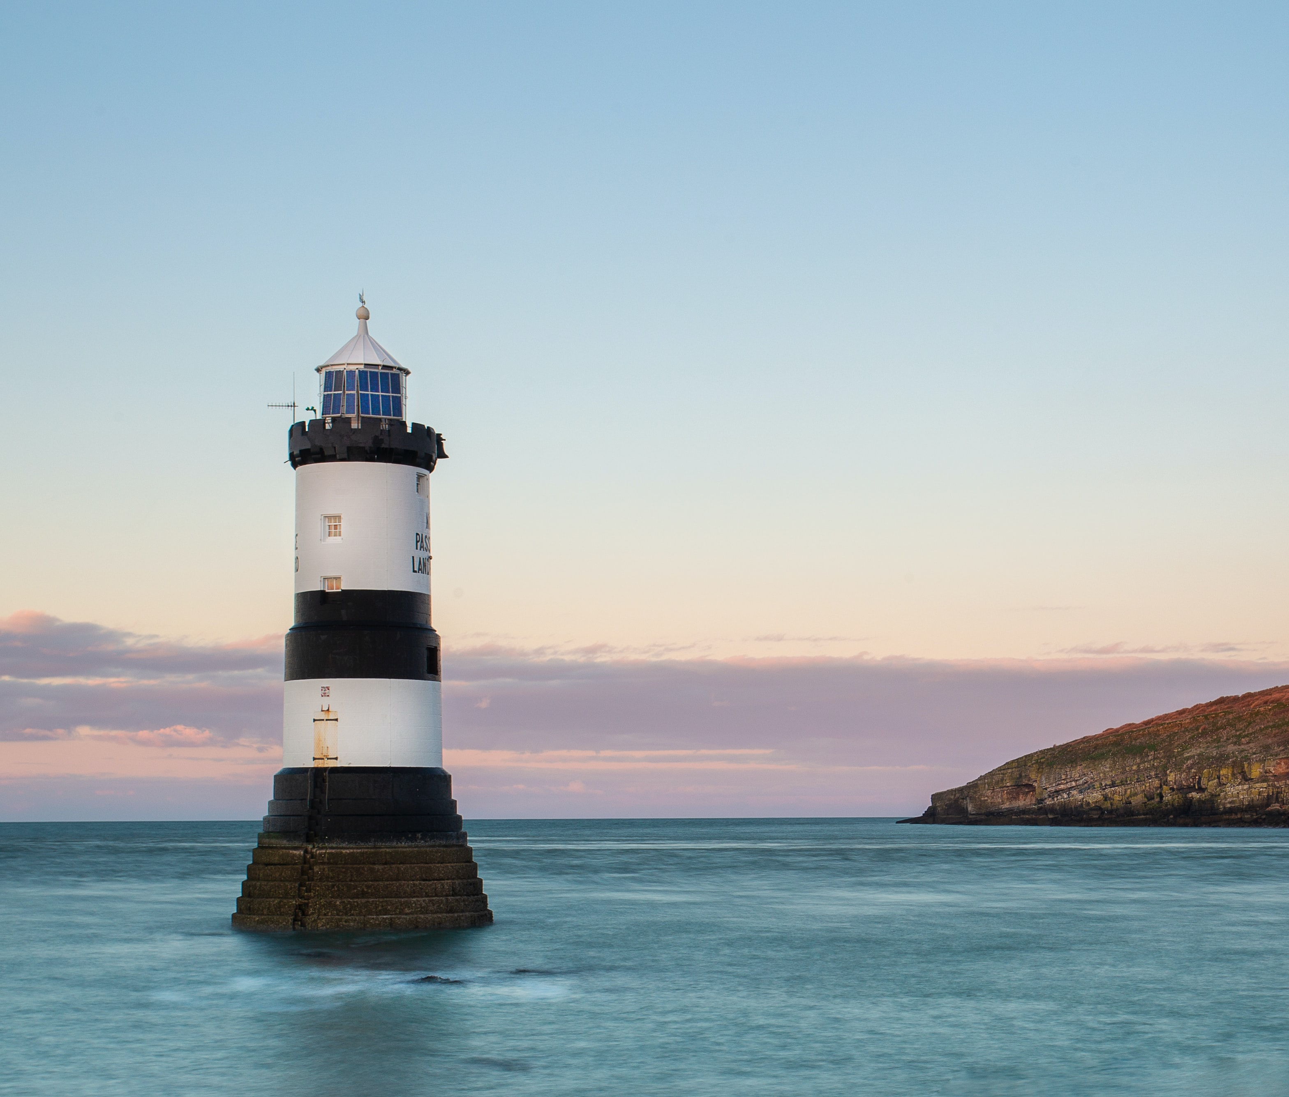
STREAM
Monitored data
Temperature
Nutrients
Oxygen
Phytoplankton
Purpose:
to monitor the Coastal and Estuarine environment around both Ireland and Wales

Slide 3
Approach
2-pronged approach
Asses thermal preferences of selected finfish
Model possible effects of future CC
What fish prefer
What is available

Slide 4
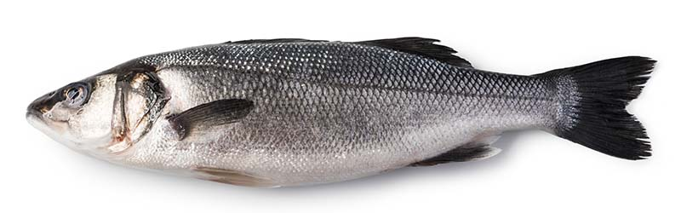
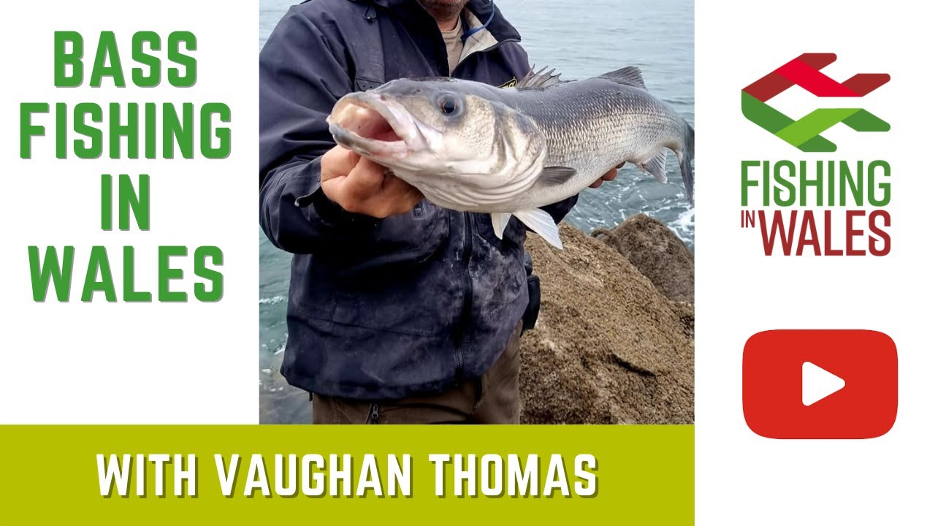
1. Seabass
Sport & Commercial
Fisheries in Irish Sea
Three
Study species

Slide 5

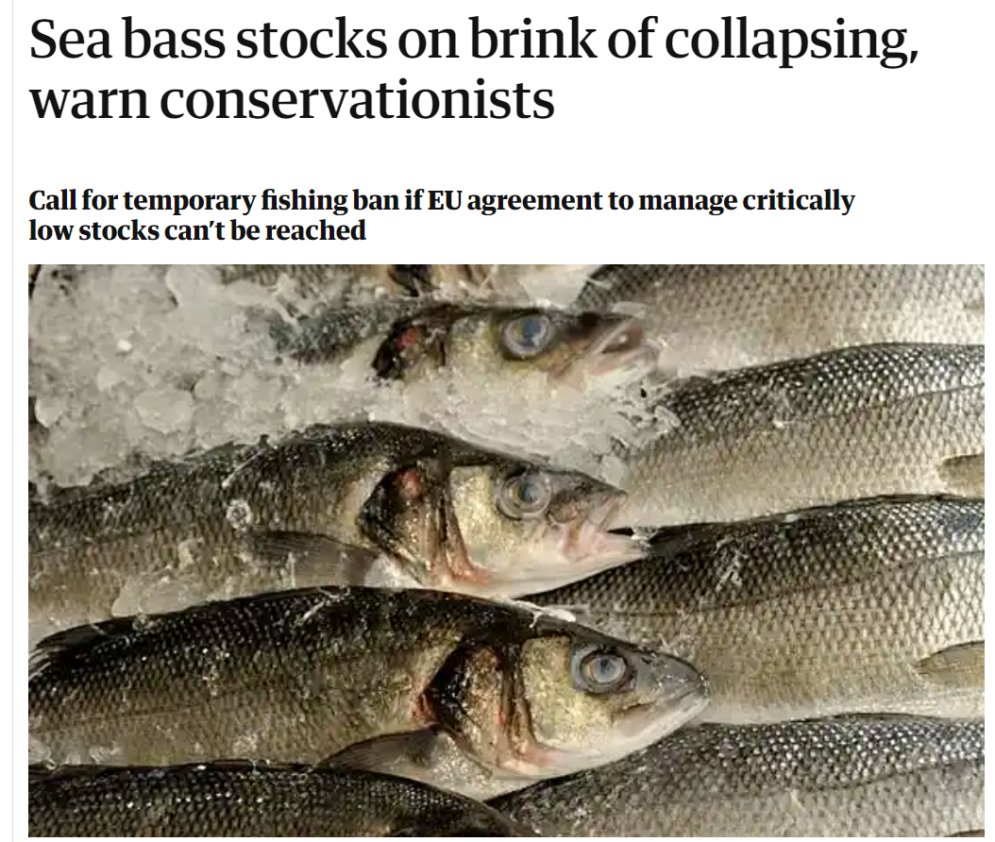
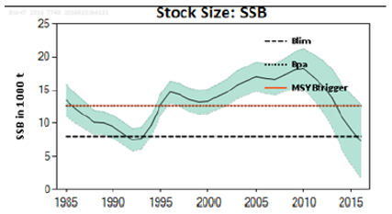
Celtic & Irish Sea seabass are slow growth stocks
Declined markedly since 2010, due to overfishing & climate change

Slide 6
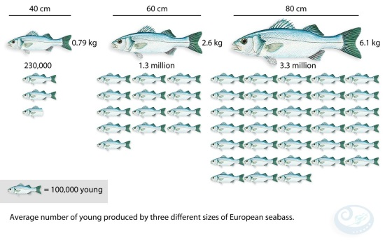
Double whammy of CC & overexploitation
Hot
Cold
c
c

Slide 7
Double whammy of CC & overexploitation
Hot
Cold
c
c

Slide 8
Double whammy of CC & overexploitation
Hot
Cold

Slide 9
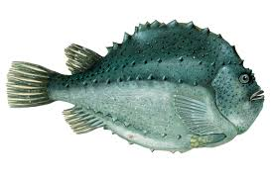
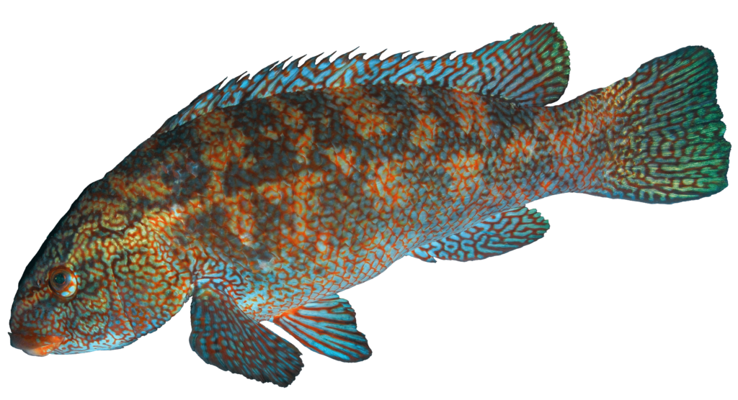
2. Lumpfish
Used as cleaner fish for sea lice control in salmon farming
Three
Study species
3. Ballan wrasse
Wales is largest UK producer of cleaner fish

Slide 10
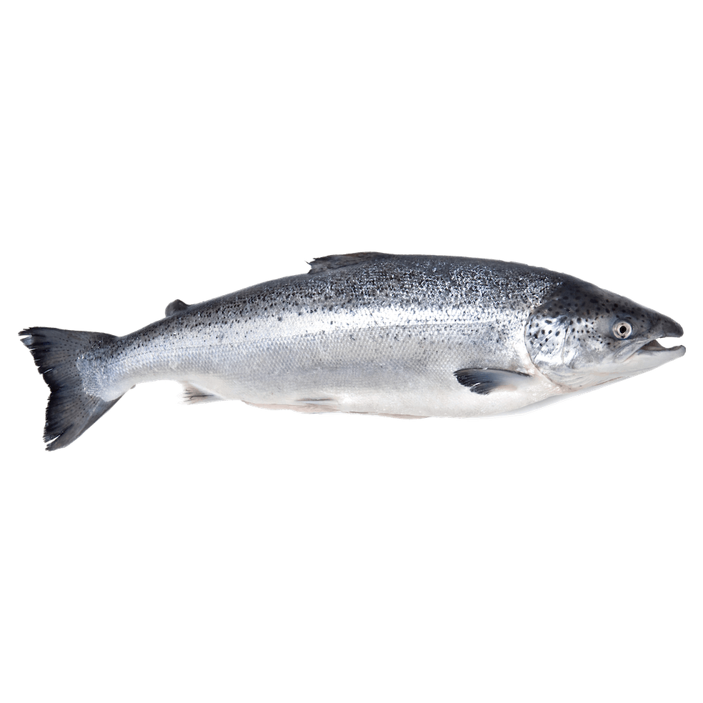
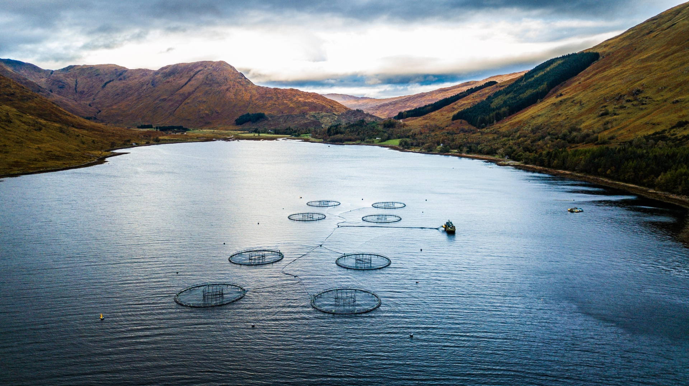
Cornerstone of UK aquaculture
41% of seafood exports
£705M

Slide 11
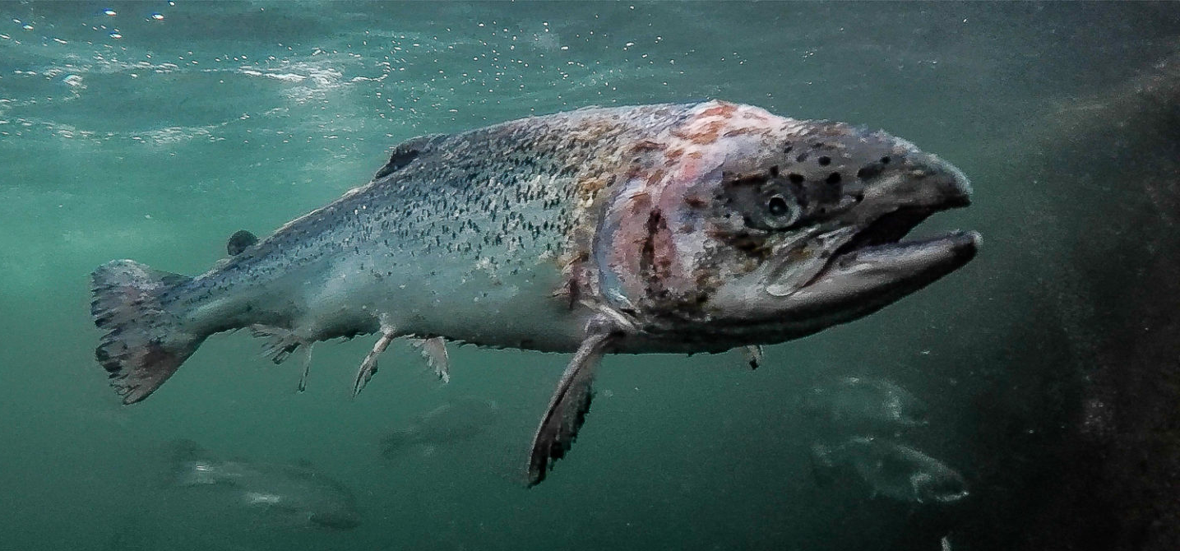
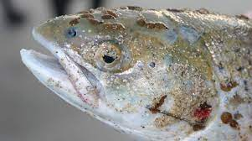
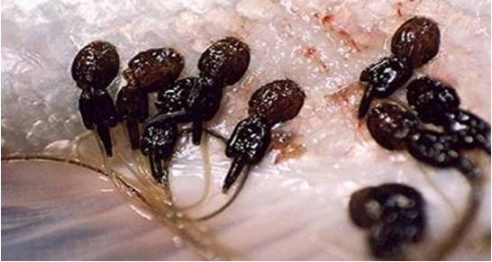
Sea lice kills
No. 1 threat to salmon farming, costing £700M

Slide 12

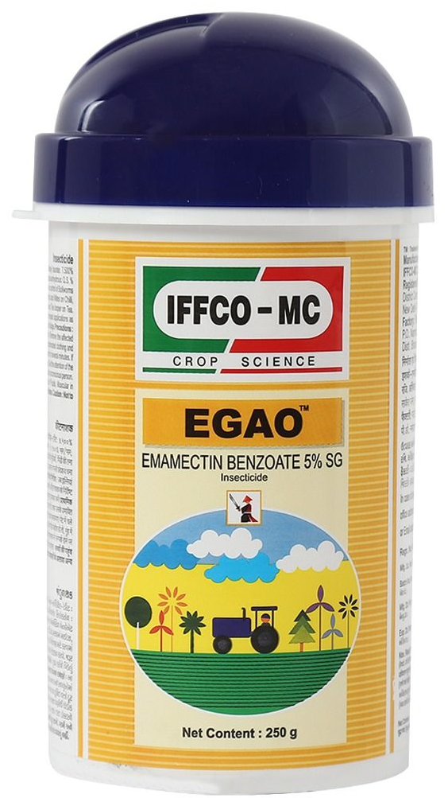
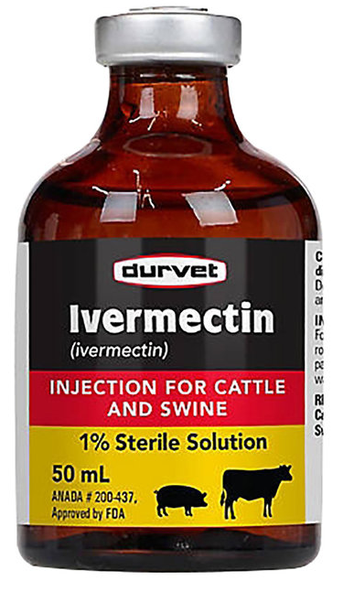

The pesticide solution

Slide 13
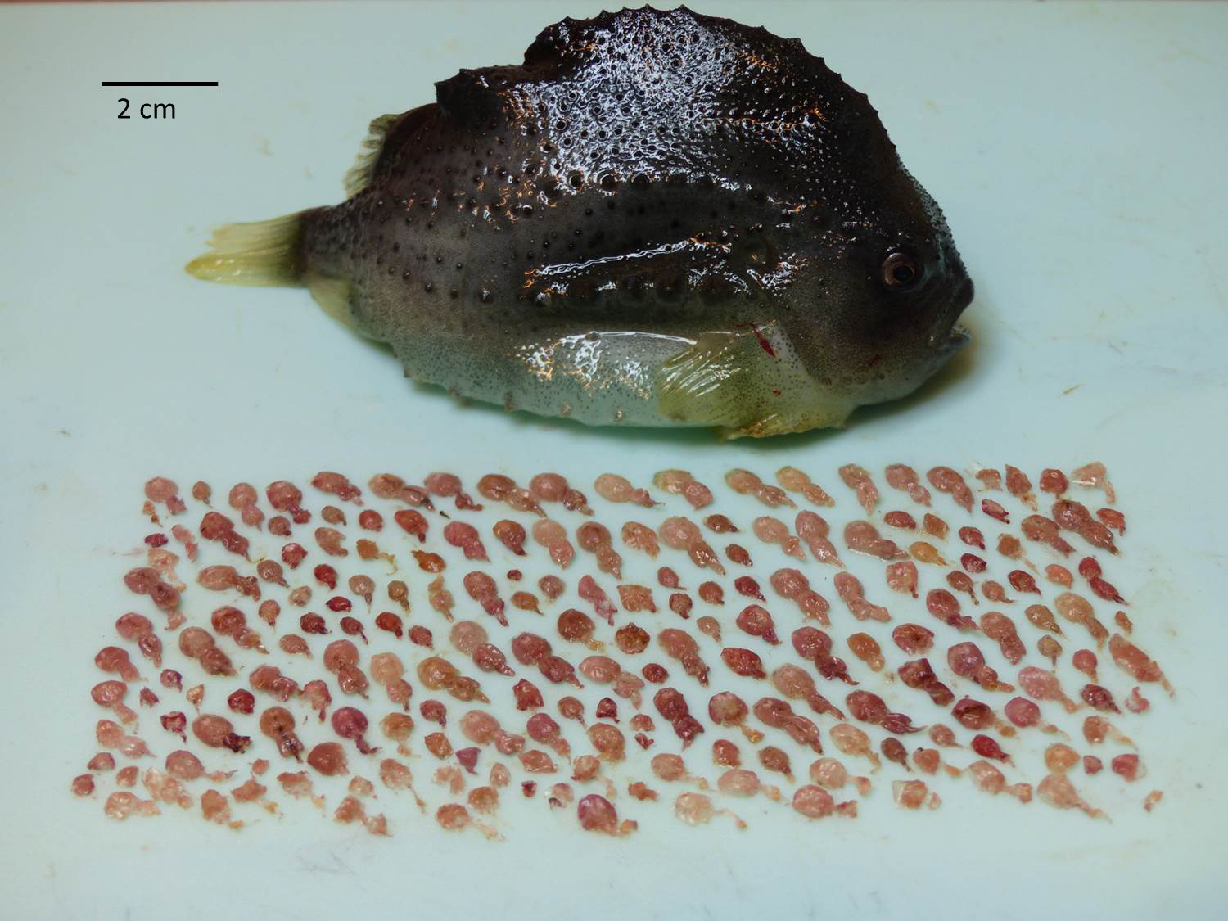
The Cleaner fish solution: a “green” alternative for pest control

Slide 14
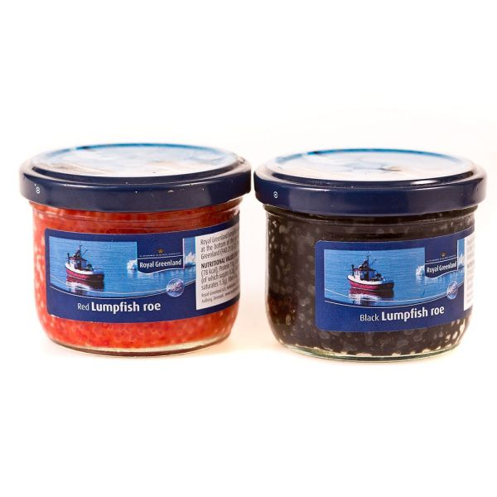
Previous commercial use of Lumpfish (fisheries)

Slide 15
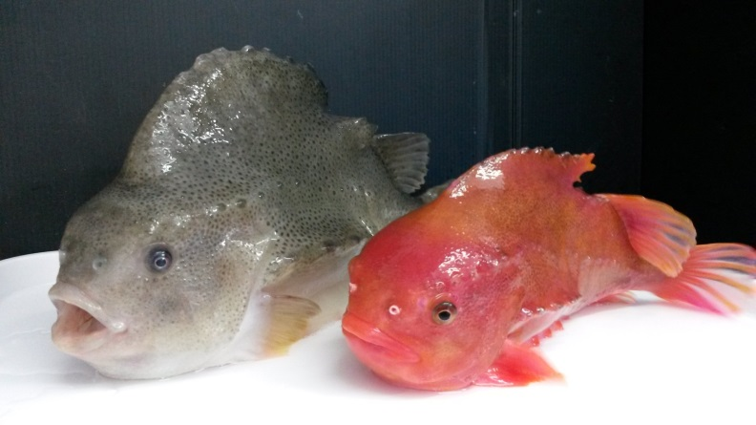
Growth of the cleaner fish industry
demand 50M/yr

Slide 16
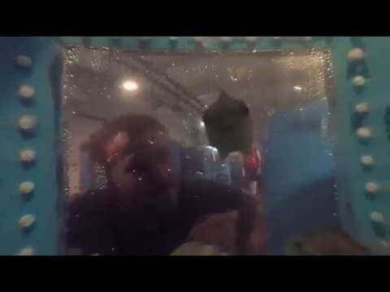
http://smartaqua.org.uk/about-2/cleaner-fish/

Slide 17
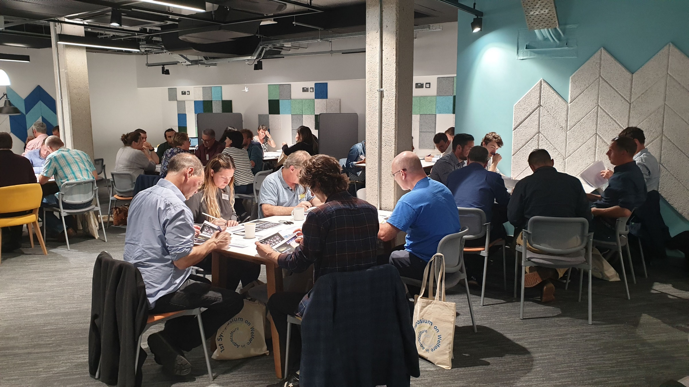
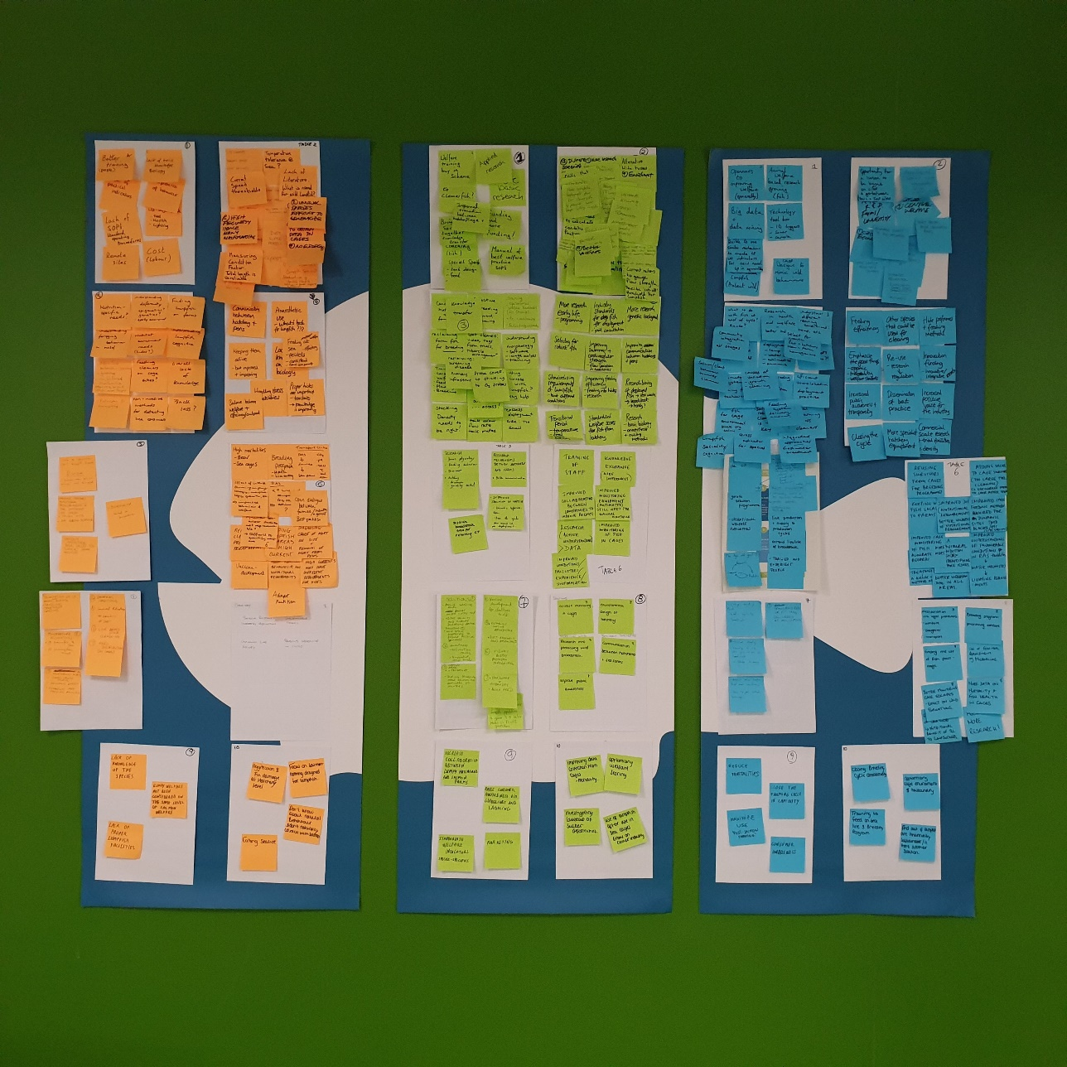
Gap analysis to overcome main challenges

Slide 18
Gap analysis to overcome main challenges

Slide 19
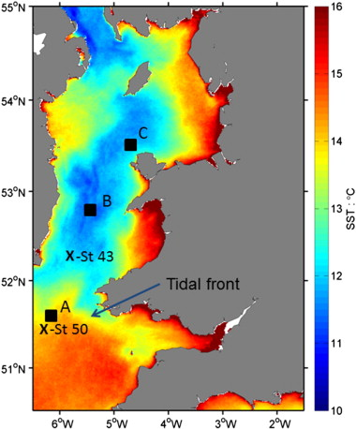
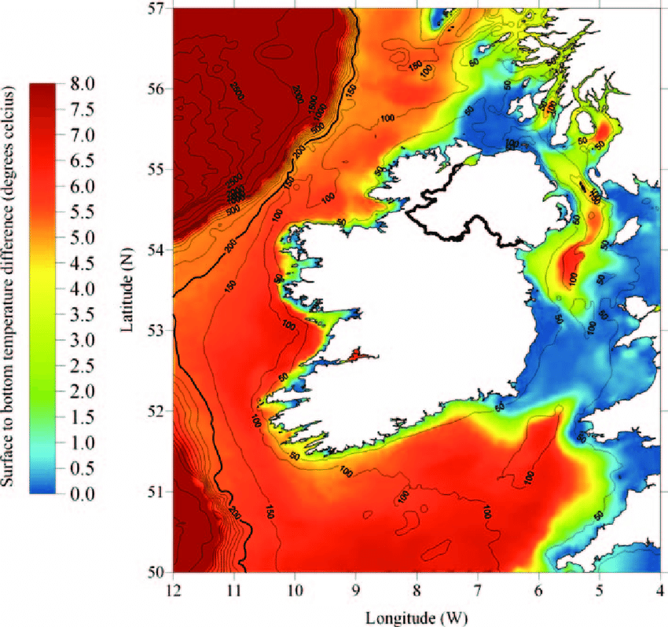
Climate Change scenarios
Climate Change in the Irish Sea
SST increased by 0.6°C per decade since 1994
Highest rate of increase in 150-year record

Slide 20
Modeling
SST data
Used EPA SST data from 1992 to 2021
N = 2,019 valid records
Collected at depths of 0-13 m
Ad-hoc data, unbalanced (not every month represented in every year)
Collected at 28 sampling sites

Slide 21
SST in Irish Sea (EPA data 1992-2021)
Patchy &
incomplete but useful to build thermal suitability envelopes

Slide 22
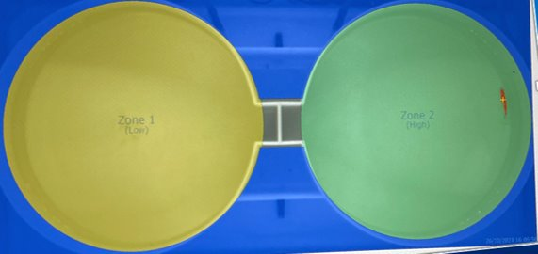
Fish Thermal preferences
Use of a Shuttle-box
fish
HOT
COLD

Slide 23
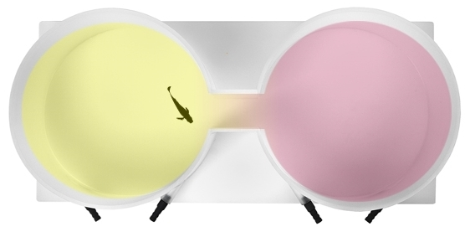
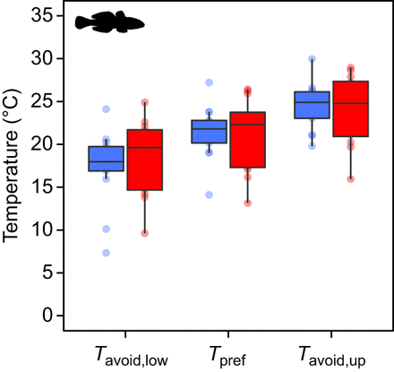
Predicting changes in the Irish Sea with climate change
Shuttle box preference experiments
Shuttle box allows choice experiments
Temperature, pH, conductivity and DO sensors allow automated control of water quality parameters on each side of shuttle box
Preferences and avoidances can be fed into habitat suitability models to predict future changes with climate change
Temperature preference and avoidance temperature of round goby (Christensen et al., 2021)

Slide 25
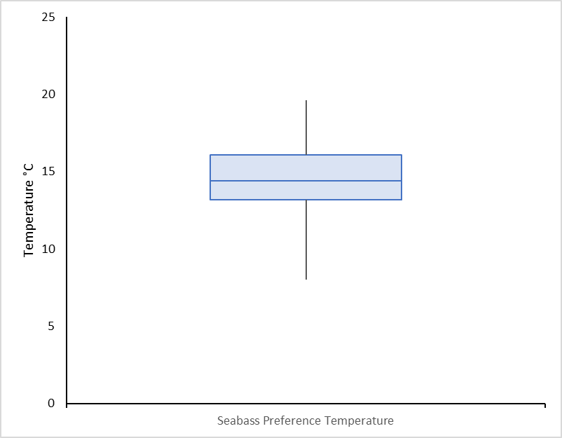
Results n = 32 seabass
14.8ºC
Thermal preferences
19.5 ºC
Optimal range
16.0 ºC
13.5 ºC
8.0 ºC
Seabass

Slide 26
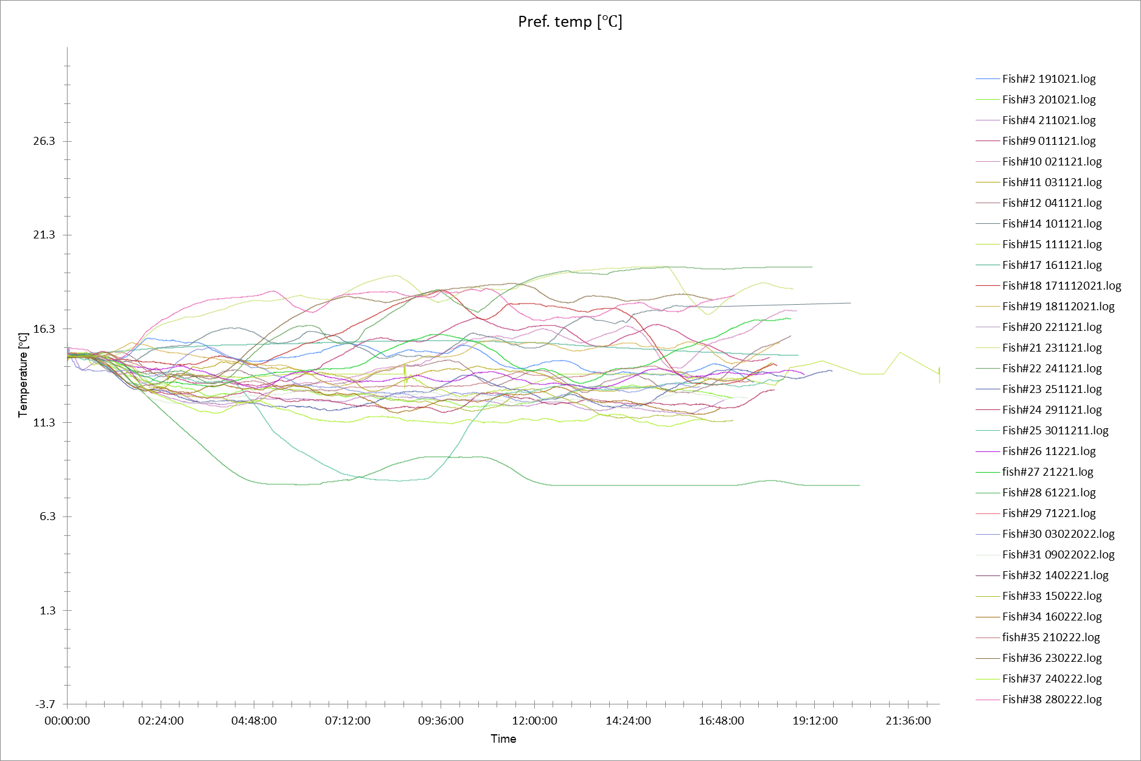
Large individual variation in thermal preferences
32 seabass
12ºC diff.
Temperature (ºC)
<3 hrs
Time (hrs)

Slide 27
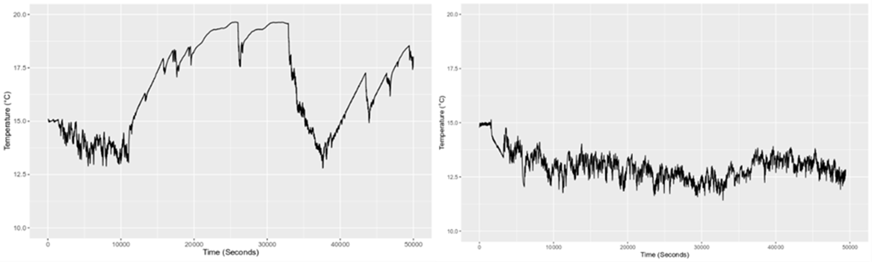
Large individual variation in thermal preferences
20.0
20.0
7ºC
3ºC
10.0
10.0
Low homeostasis
High homeostasis

Slide 28
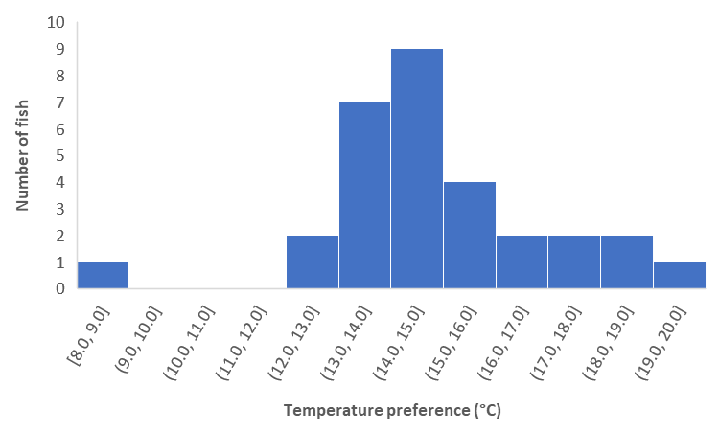
Thermal niche seabass
psychrophilic
thermophilic
<15ºC
>15ºC

Slide 29
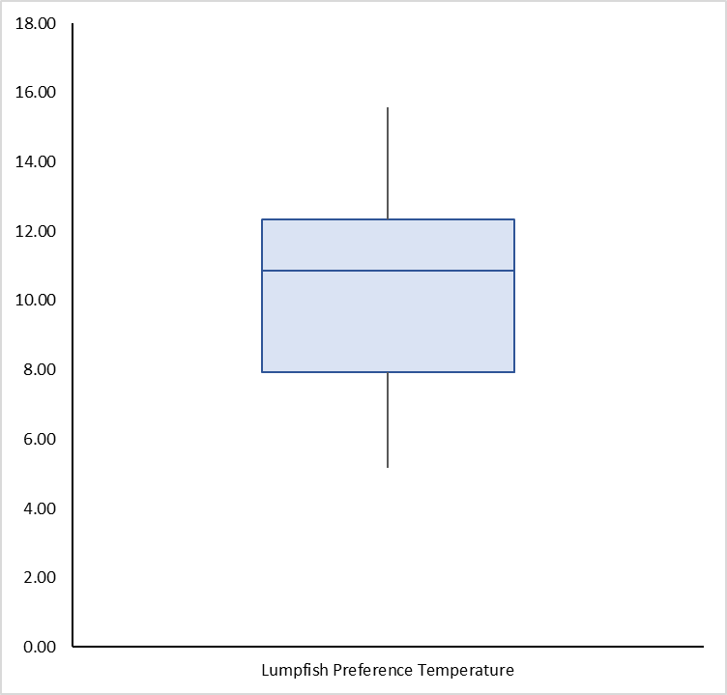
Results n = 30 lumpfish
10.2ºC
Thermal preferences
15.6 ºC
12.3 ºC
Optimal range
7.9 ºC
5.2 ºC
Lumpfish

Slide 30
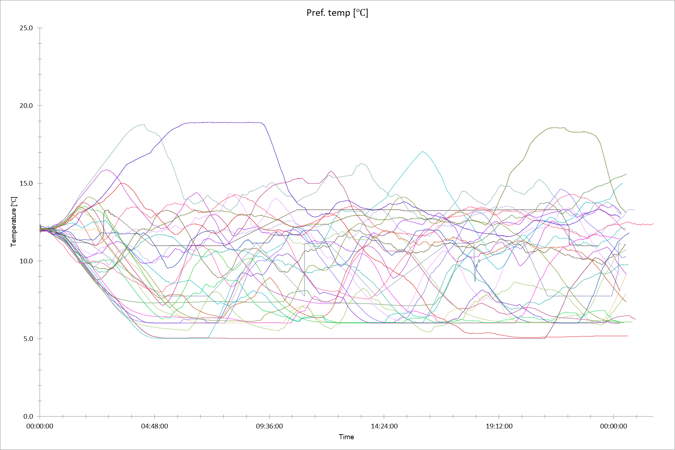
Large individual variation in thermal preferences
25
30 lumpfish
20
15
Temperature (ºC)
14ºC diff
10
<4 hrs
5
0
Time (hrs)

Slide 31
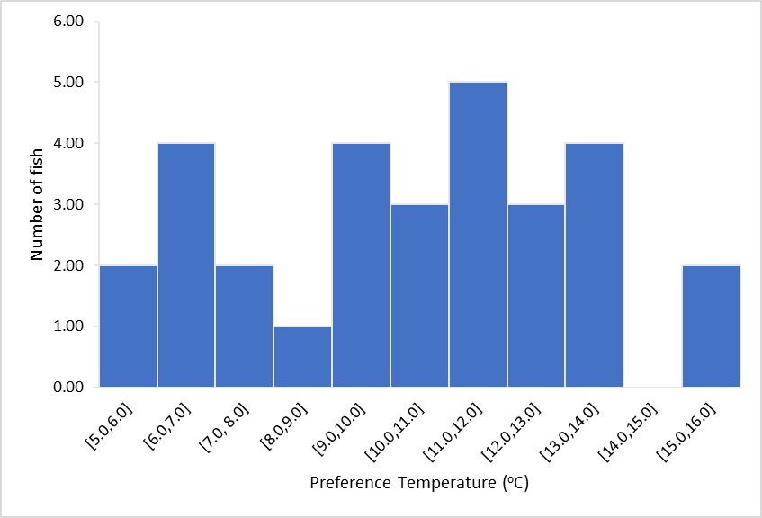
Thermal niche lumpfish
psychrophilic
thermophilic
<10ºC
>10ºC

Slide 32
Results n = 30 wrasse
12.8ºC
Thermal preferences
15.5 ºC
13.8 ºC
Optimal range
12.0 ºC
9.9 ºC
Wrasse

Slide 33
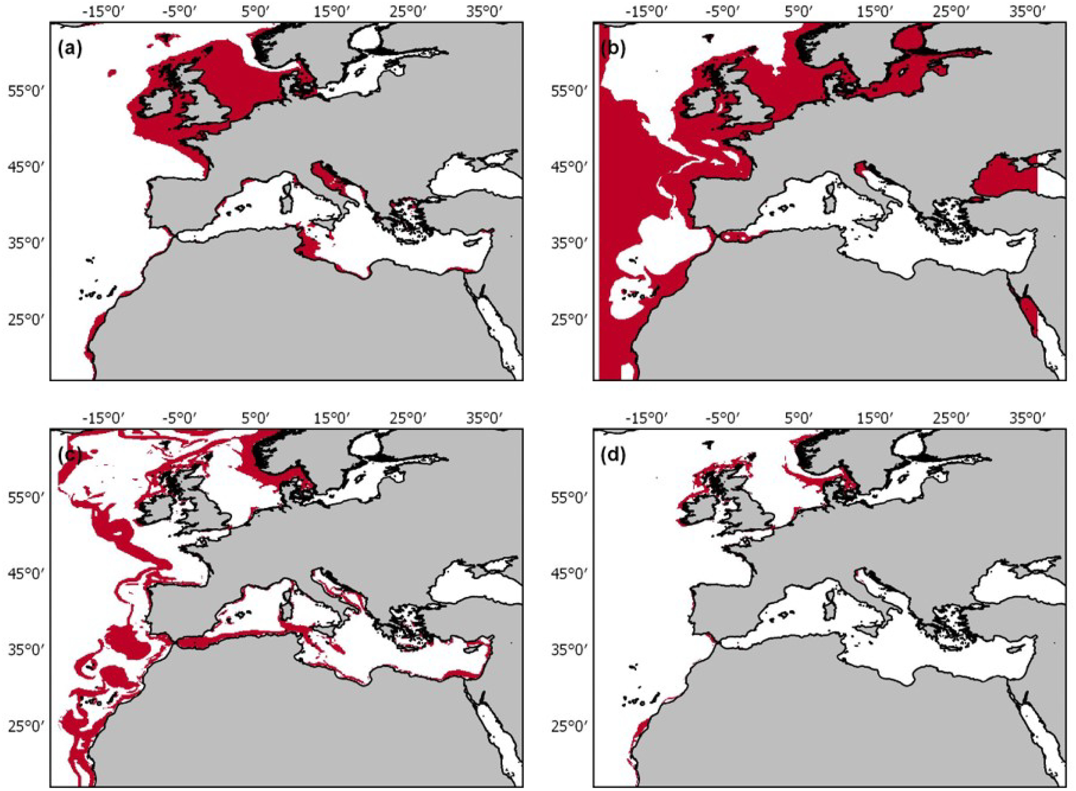
Suitability mapping
Suitability mapping using experimental data from STREAM sensor network
Model habitat envelopes for target fish species in the Irish Sea
Pacific oyster cultivation suitability under climate change scenarios (Palmer et al., 2021)

Slide 34
Seabass current suitability
optimal
seabass
too cold
too hot

Slide 35



Seabass current suitability
86%
15%
71%
psychrophilic
thermophilic

Slide 36
Lumpfish current suitability
too hot
optimal
lumpfish
too cold

Slide 37
Lumpfish current suitability
13%
psychrophilic
55%
thermophilic

Slide 38
Modelling
Estimate impacts of future climate change scenarios
Assess future opportunities and challenges

Slide 39
Seabass future suitability
37%
17%
20%
63%
psychrophilic
thermophilic
10
15
20
25

Slide 40
Lumpfish future suitability
7%
83%
thermophilic
10
15
20
25

Slide 41
Predicted scenarios under Climate Change
Observed rate of warming may shrink the optimal thermal niche in the Irish sea as follows:
from 86% to 37%
from 13% to 7%

Slide 42
Predicted scenarios under Climate Change
Without an adaptive response (migration or adaptation) populations could decline by:
57%
46%

Slide 43
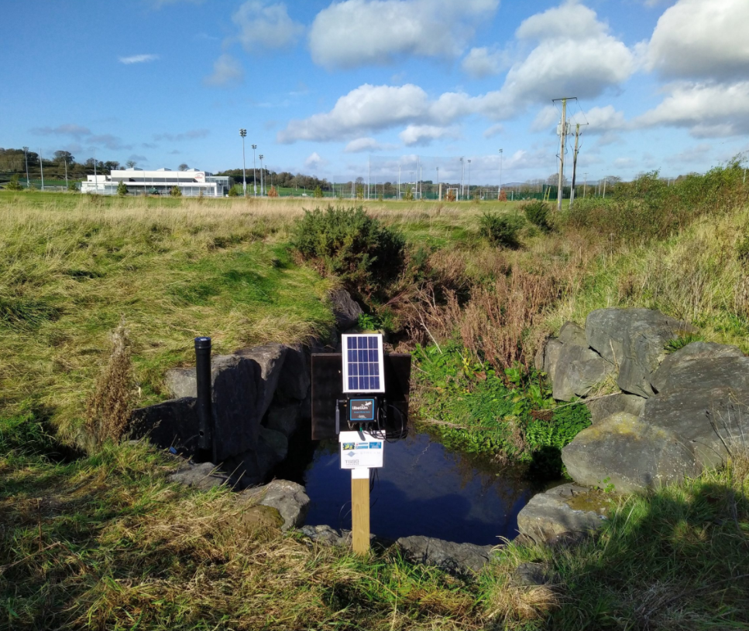
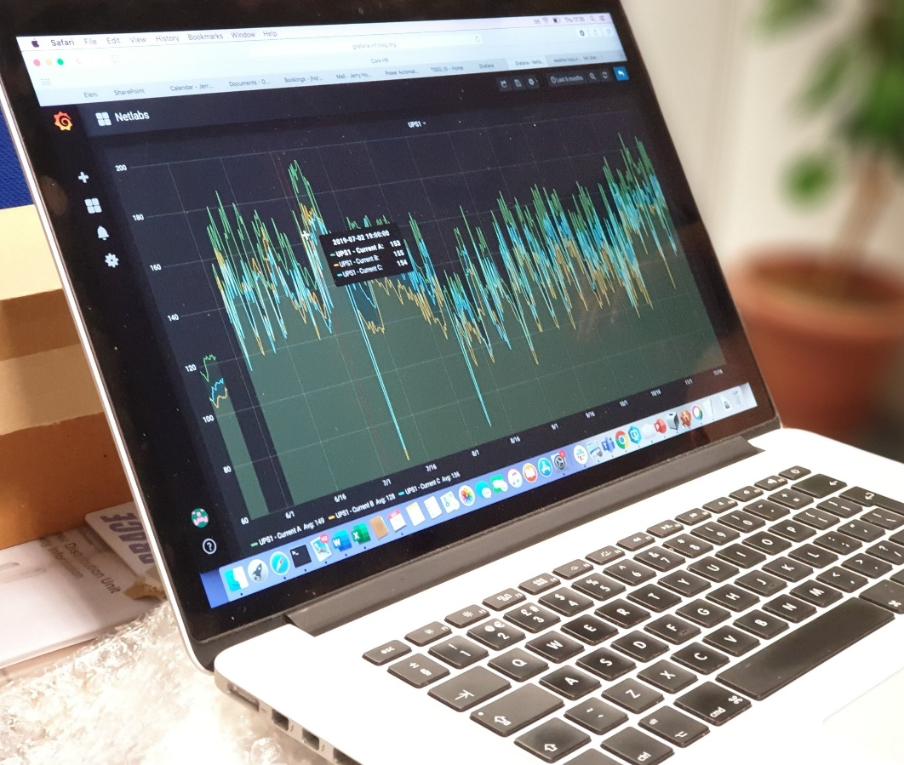
Take home message
Accurate thermal monitoring will become increasingly important for proactive adaptive management

Slide 44

Thank you
Dr. Peter Jones
Ben Overland
Chloe Woodland
Joshua Anthony
Prof. Sofia Consuegra
Prof. Luca Borger
Dr. Sara Barrento
Isla Monaghan
Synne Klute
Gemma Winslade
Sarah Weller
Jack Van Ecker
Heidi Rehwald
CSAR Technicians & Management Team

