Slide 1
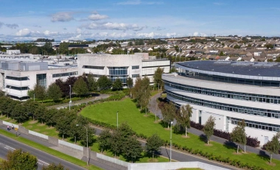
Designing, Fabricating, and Optimizing an Optical Sensor to Detect Marine Toxins
Ferritin
Simulation
STREAM
SPR
DTL
Conclusion
The End
Sensor
Marine toxins
Mitra Abedini Postdoctoral researcher (Development Scientist)
Department of Science PMBRC
mitra.abedini@setu.ie

Slide 2
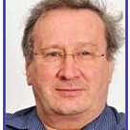
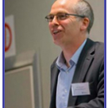
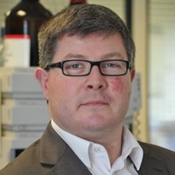
Sensor Technologies for Remote Environmental Aquatic Monitoring
Swansea University
MTU
SETU
Dr Joseph O’Mahony
PI
Prof David Gethin
Cormac Gebruers
Ferritin
STREAM
SPR
DTL
Simulation
Sensor
Conclusion
Marine toxins
The End
Dr Peter McLoughlin PI
Dr Ben Clifford
Dr Ambrose Fury
Dr Ronan Browne Project Manager
Prof. Carlos de Leaniz
Dr Mitra Abedini postdoctoral
researcher
Paul Shanahan
Dr Sara Barrento
John Ronan Technical lead
Mike Griew
Paul Howes
Benyuan Yu
PhD researcher

Slide 3
04
03
02
01
Neurotoxic shellfish toxins (NSTs)
Diarrhetic shellfish toxins (DSTs)
Amnesic shellfish toxins (ASTs)
Paralytic shellfish toxins (PSTs)
08
07
06
05
Cyclic imines
Palytoxins
Tetrodotoxins (TTXs)
Ciguatoxins
economic impact of marine toxins
Ferritin
STREAM
Simulation
SPR
The End
Sensor
Conclusion
DTL
Marine toxins
Impact | USA | Europe
Economic losses from shellfish closures | $40 million per year | €70 million per year
Costs of toxin monitoring and testing | $10-12 million | €10-15 million
Costs of treating toxin-related illnesses | $40 million
Economic impacts on tourism | $3 million | to £22 million

Slide 4
Optical Sensors
INFOGRAPHICS
ELEMENTS
Types
1- Surface Plasmon Resonance (SPR) sensors
2- Fluorescence-based sensors
3- Colorimetric sensors
4- Surface Raman Enhances Spectroscopy sensors
Strength
1- High sensitivity & Selectivity
2- Real-time monitoring
3- Non-destructive
4- Portability
5- Versatility
Ferritin
STREAM
Simulation
SPR
Conclusion
The End
DTL
Marine toxins
Sensor
Challenges
1- Complexity
2- Achieving high sensitivity and selectivity
3- Interference

Slide 5
light passes through a subwavelength aperture or hole in a metal film
causing plasmonic resonance that enhances transmission
SPR
Surface Plasmon Resonance
Challenges & Advantages
SPR
Ferritin
STREAM
Simulation
Sensor
Conclusion
Marine toxins
The End
DTL
EOT
Extraordinary Transmission
Light interacts with metal film
Electromagnetic field generated.
Field senses refractive index
Indicates presence of analytes
precise control over the size and shape of the metal nanostructures
minimizing non-specific binding and interference
can be integrated with microfluidic devices

Slide 6
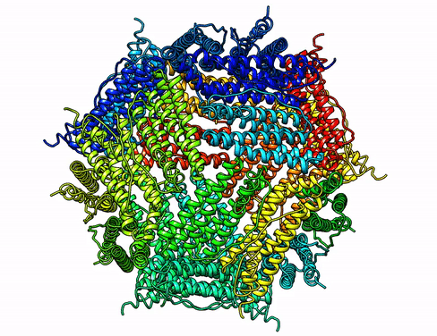
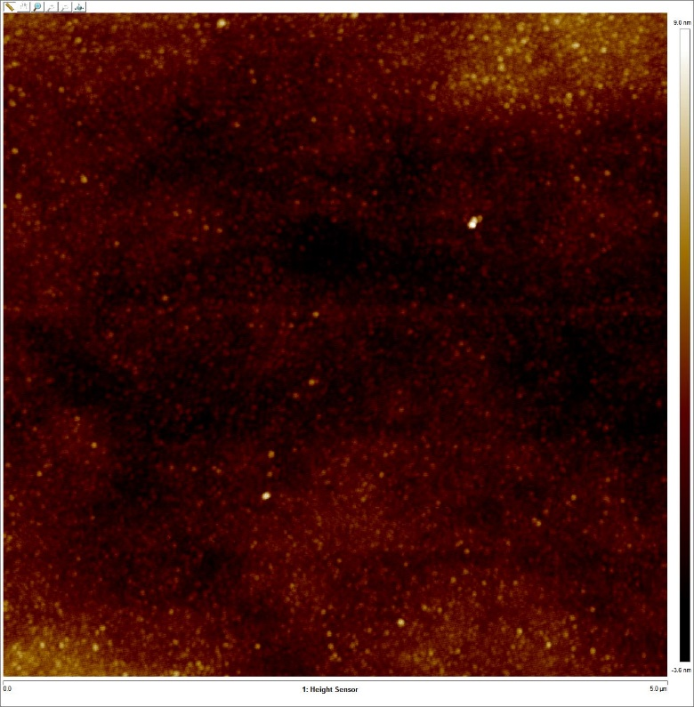
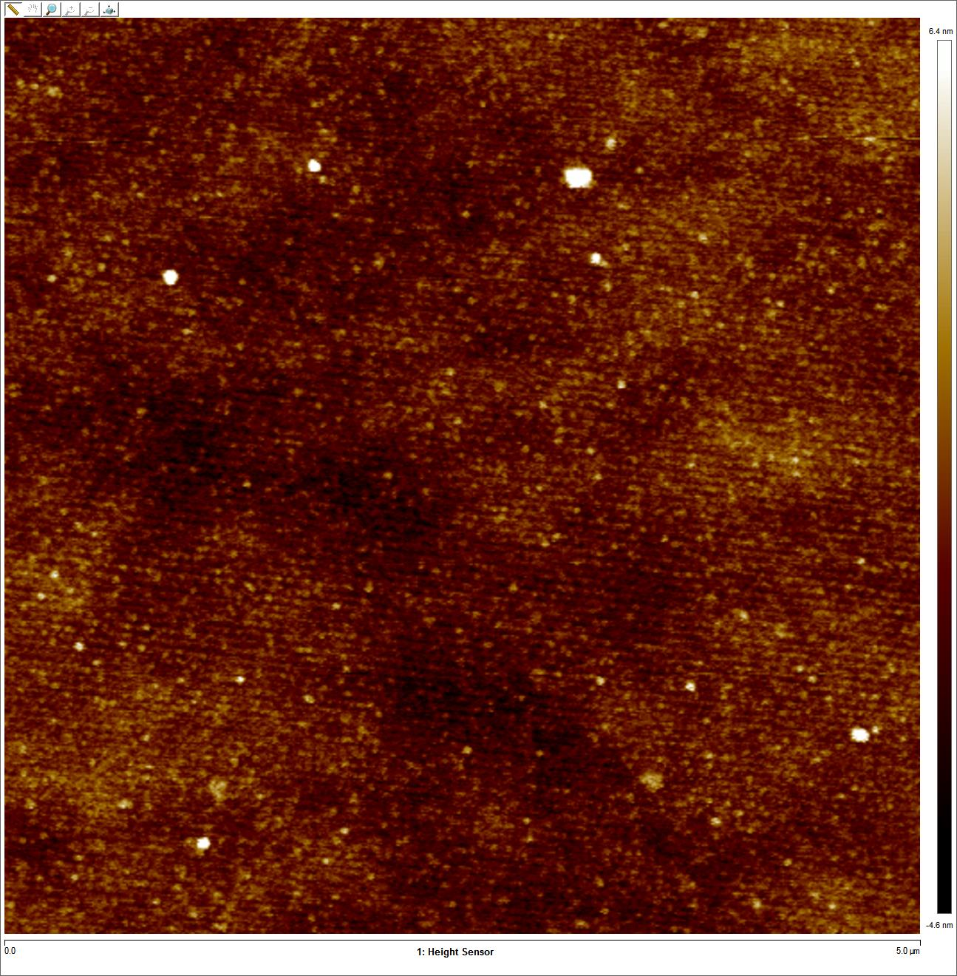
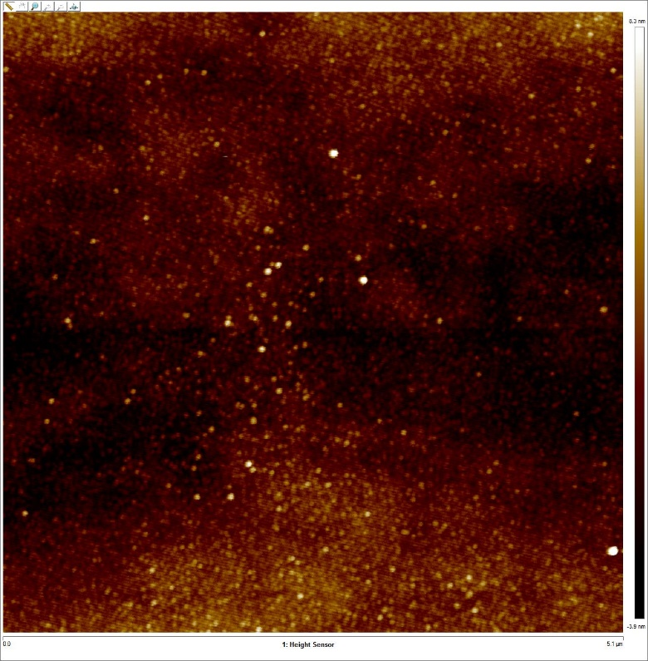
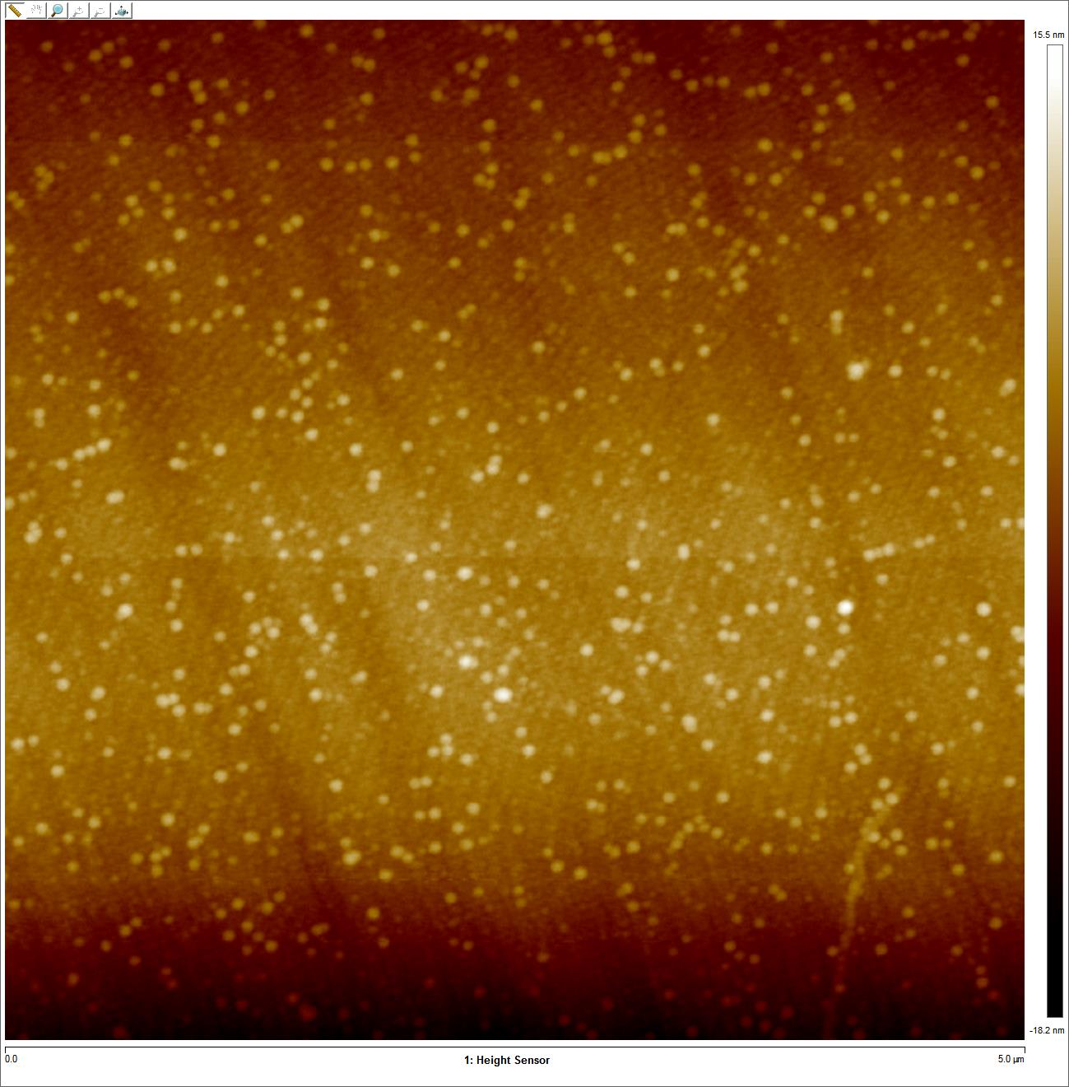
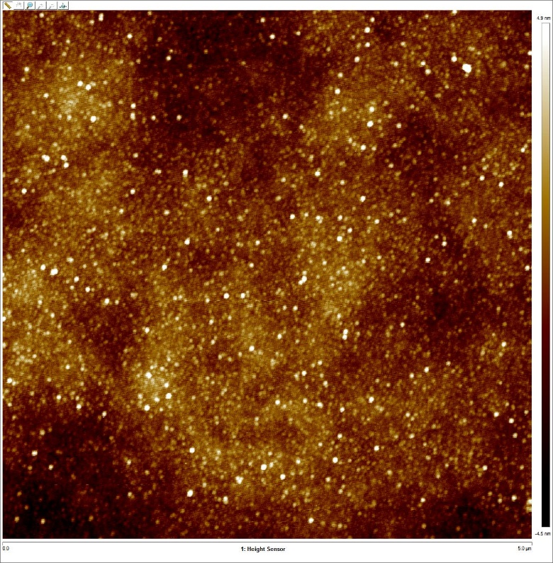
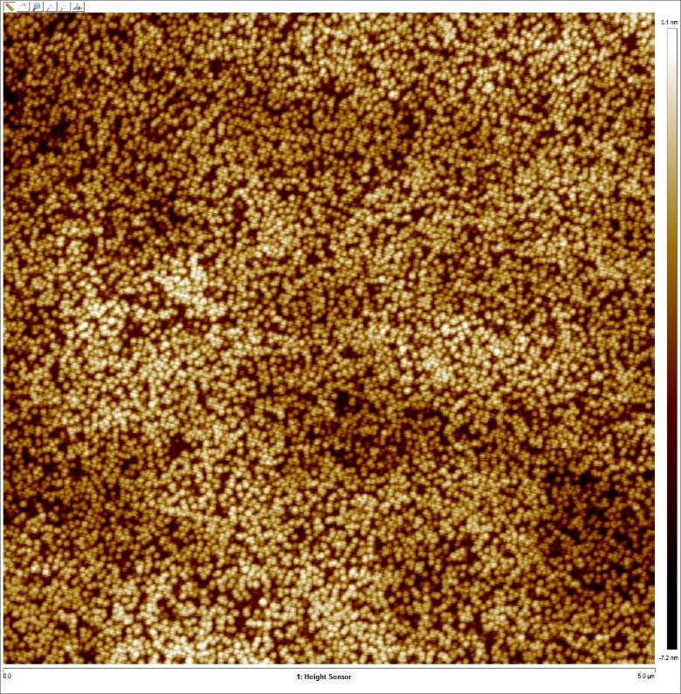
Ferritin
STREAM
SPR
Sensor
The End
Marine toxins
DTL
Conclusion
Simulation
Anti-Ferritin 20ug/ml+ Ferritin100Pg/ml
Anti-Ferritin 20ug/ml+ Ferritin10ng/ml
Anti-Ferritin 20ug/ml+ Ferritin100ng/ml
Anti-Ferritin 20ug/ml+ Ferritin1ug/ml
Anti-Ferritin 20ug/ml+ Ferritin2ug/ml
Anti-Ferritin 20ug/ml+ Ferritin6ug/ml

Slide 7
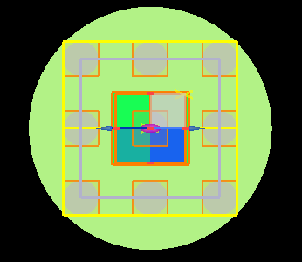
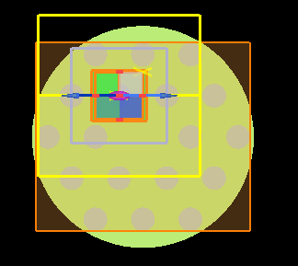
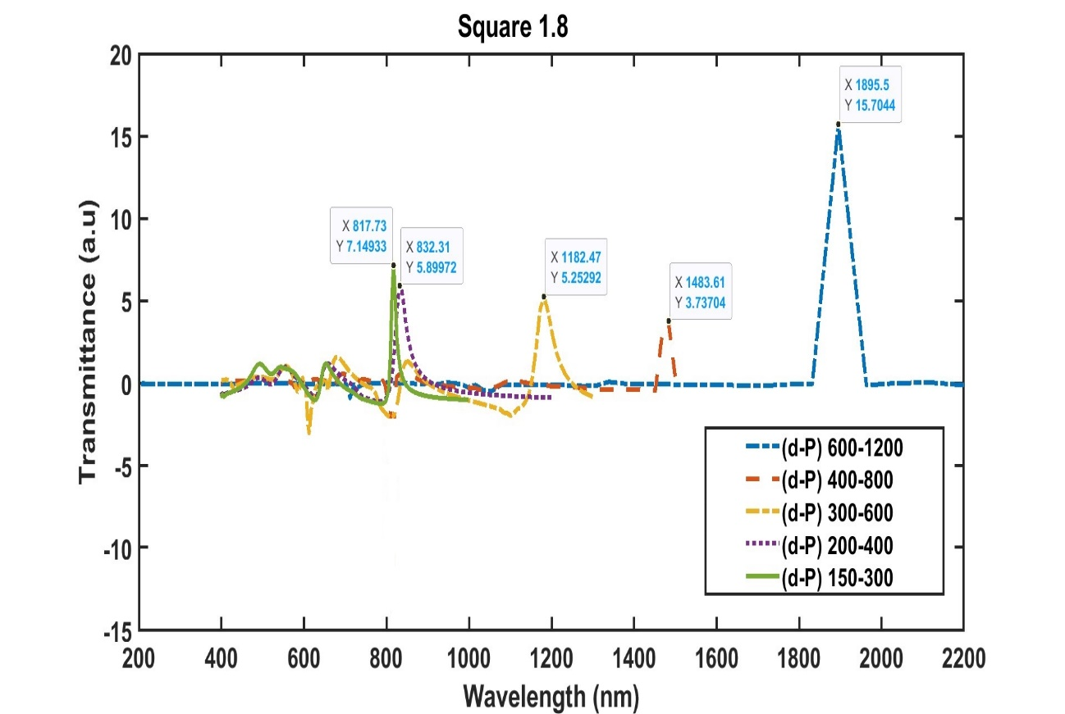
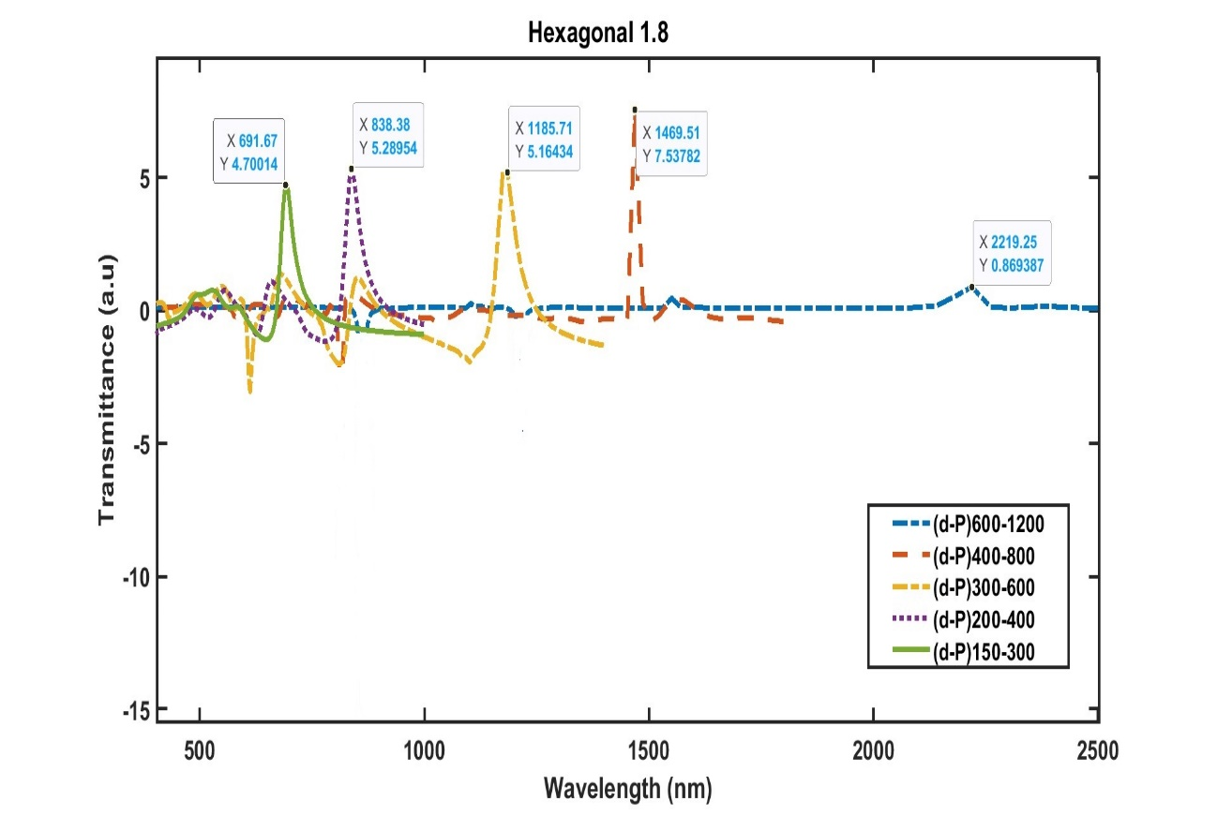
Ansys (Lumerical), Finite-Difference Time-Domain (FDTD) simulations
Ferritin
STREAM
Conclusion
SPR
DTL
Simulation
The End
Sensor
Marine toxins

Slide 8
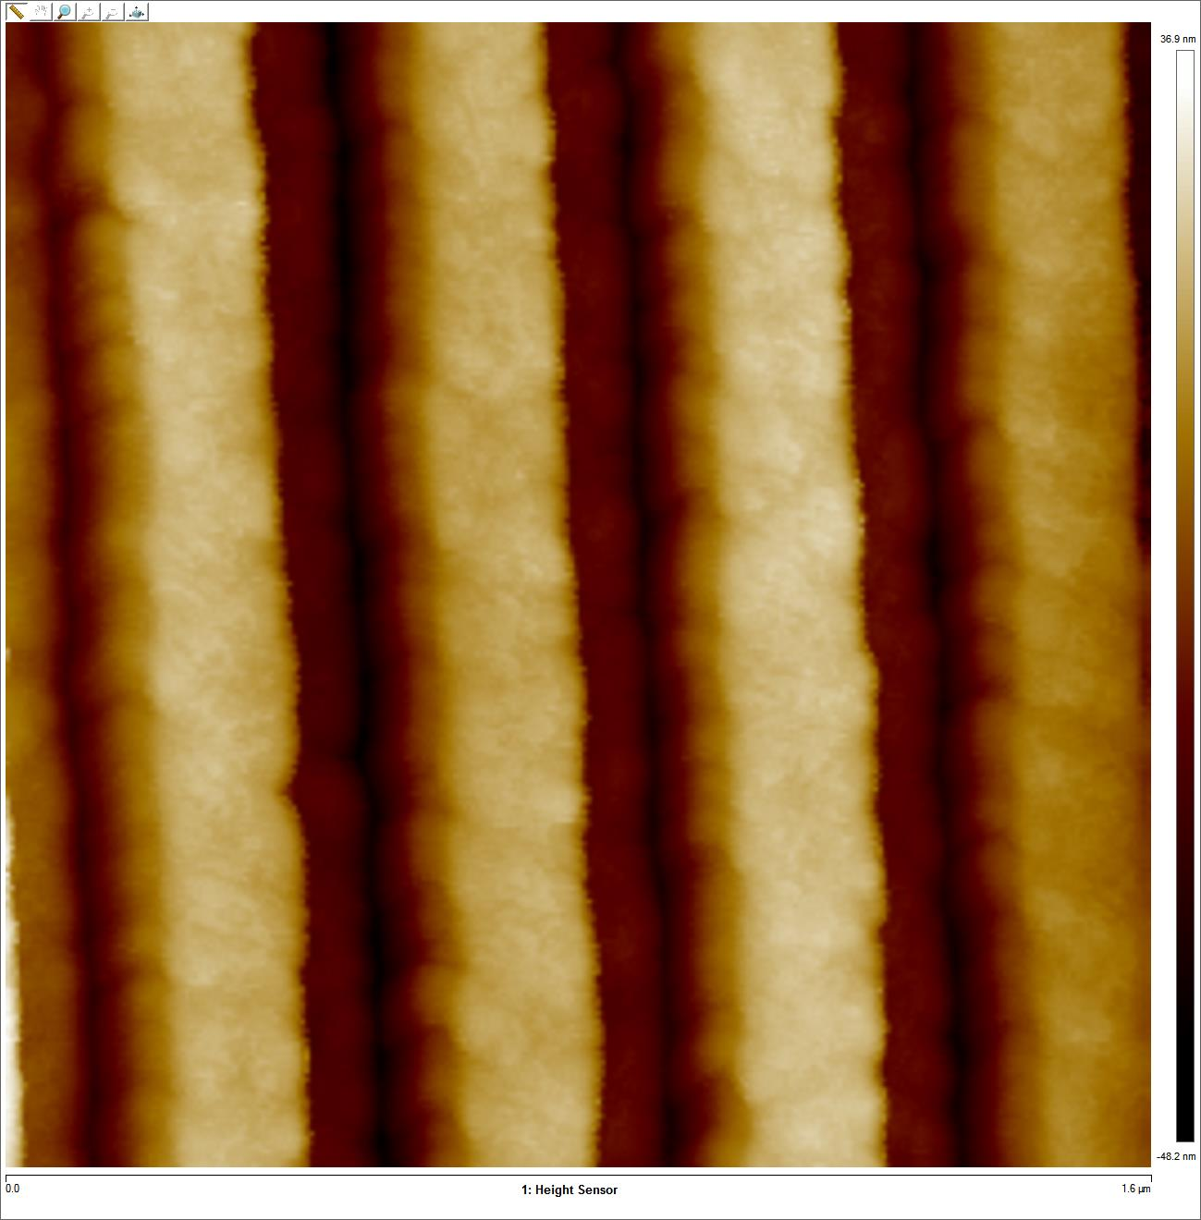
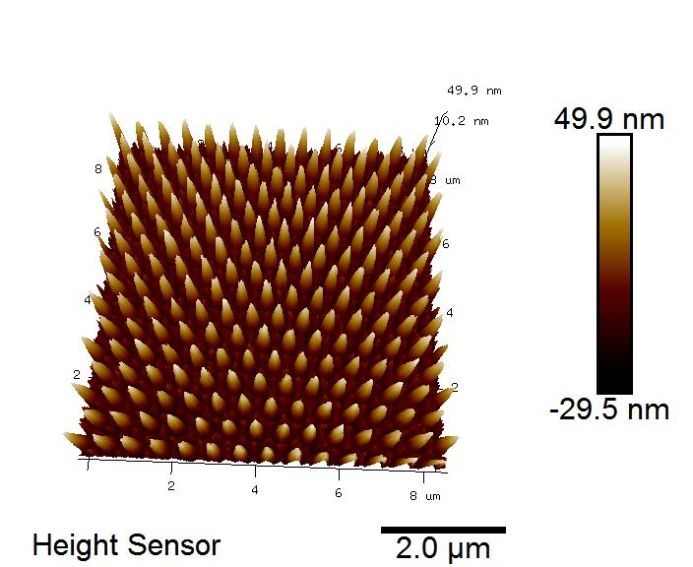
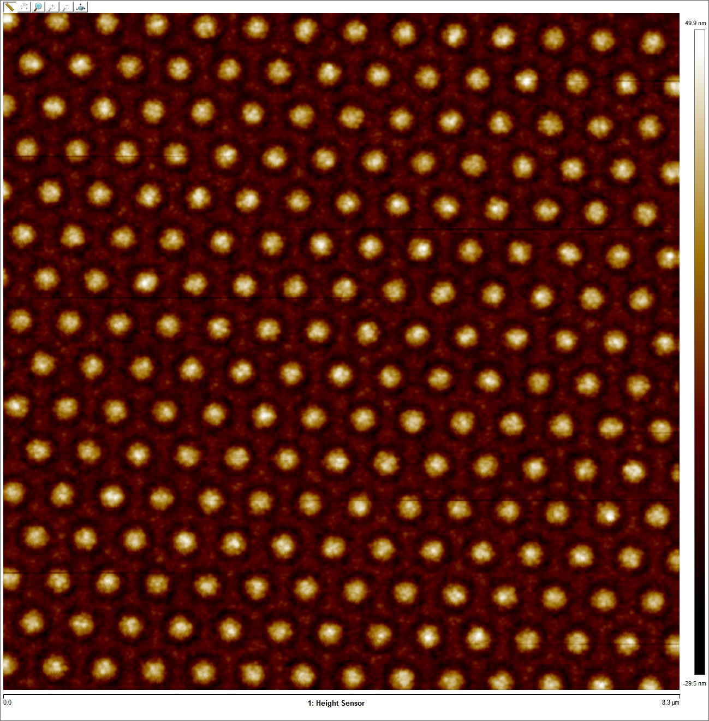
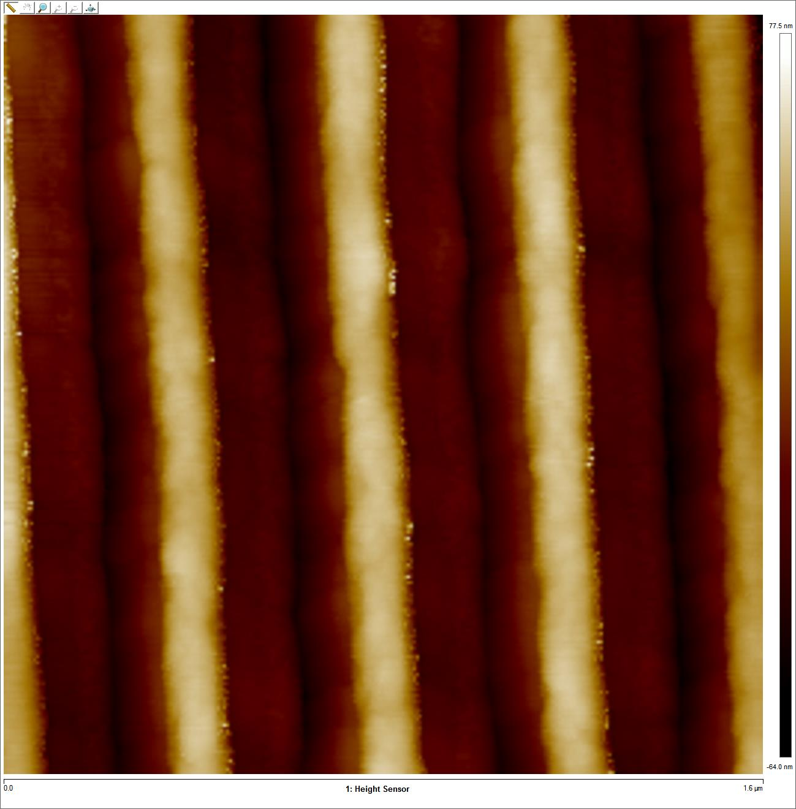
Ferritin
STREAM
SPR
Simulation
Sensor
Pathway
Conclusion
DTL
Marine toxins
The End
Nanohole arrays
Nanohole arrays
Nano slits, first exposure
Hexagonal Nanopillars, 3D
Hexagonal Nanopillars
Nano slits, fifth exposure

Slide 9
Finding a model molecule
Finding a way to immobilize it
Immobilization
Ferritin on the silicon surface
AFM imaging
STREAM
Ferritin
The End
SPR
DTL
Simulation
Sensor
Conclusion
Marine toxins
Test the sensor with model molecule &
real toxin
Microfluidic system & optical alignments
Fabrication of nanohole arrays (DTL)
Simulation studies

Slide 10
T
H
A
N
K
Ferritin
Conclusion
STREAM
The End
DTL
Simulation
SPR
Sensor
Y
O
U
Marine toxins

