Slide 1
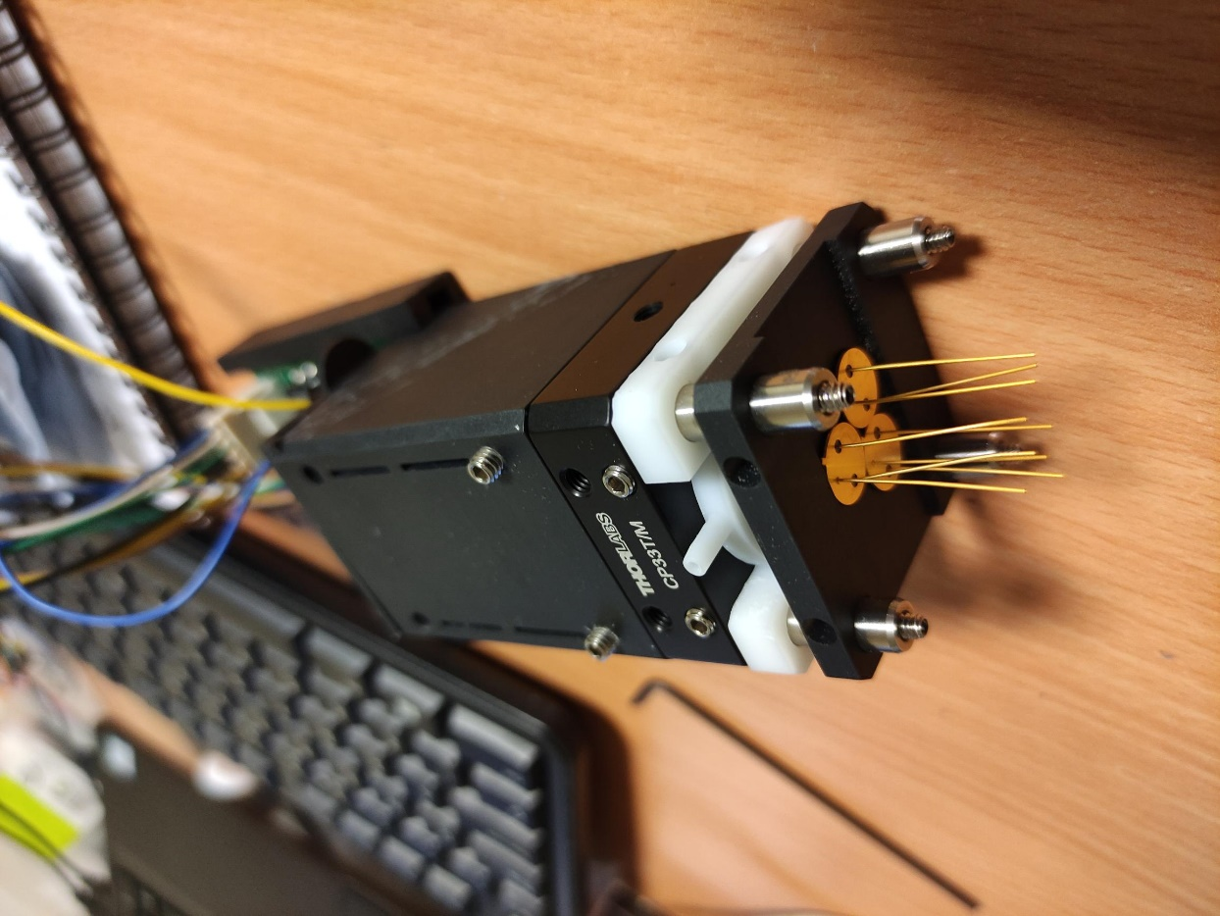
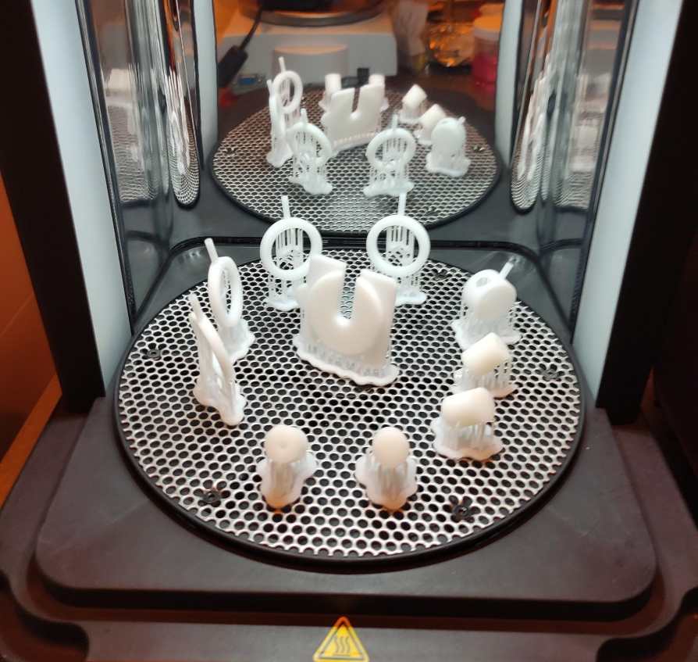
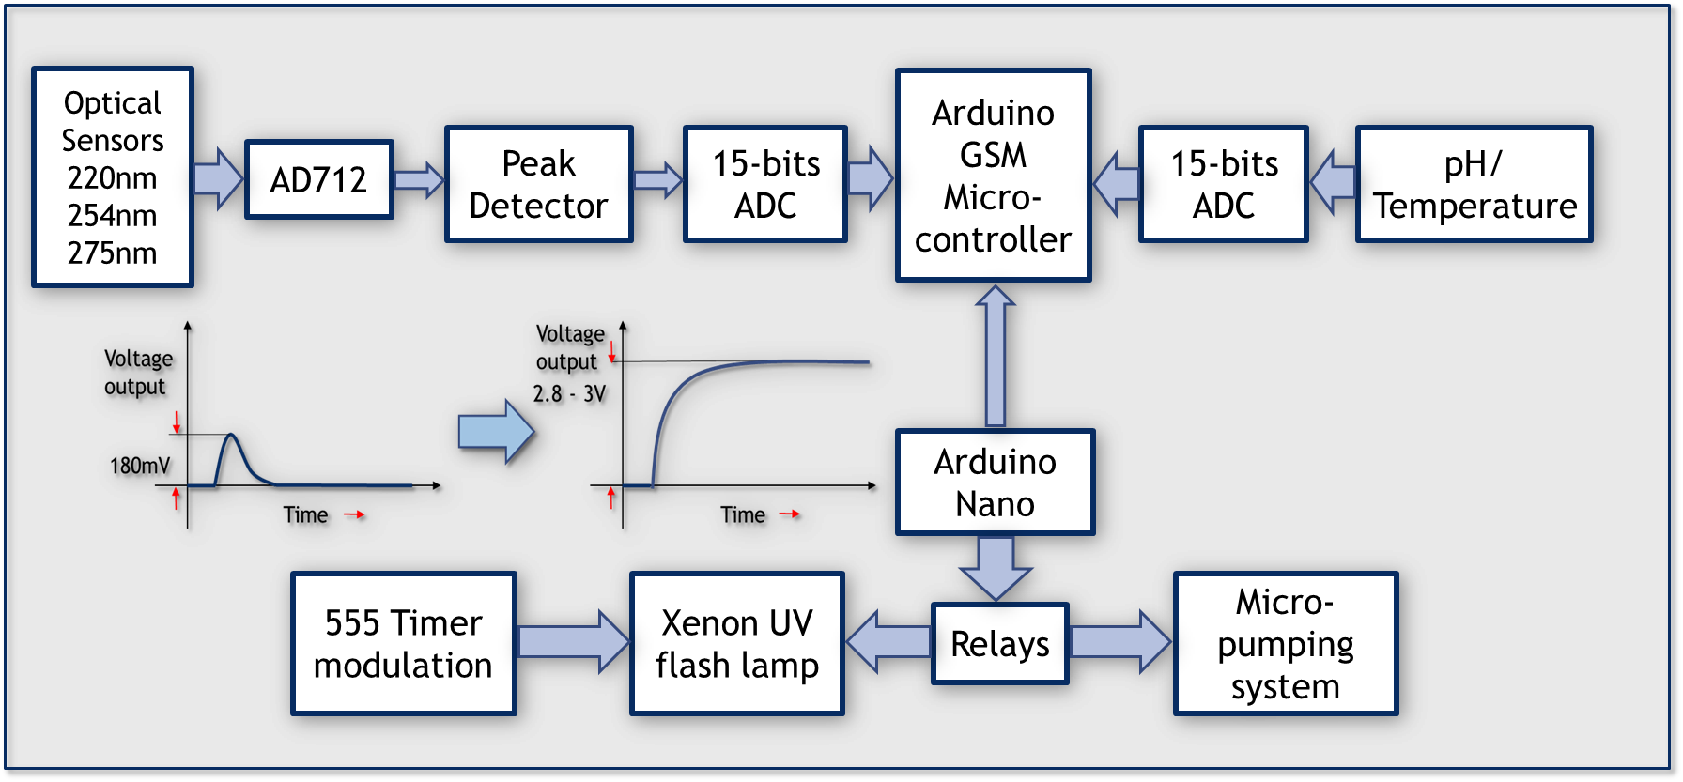
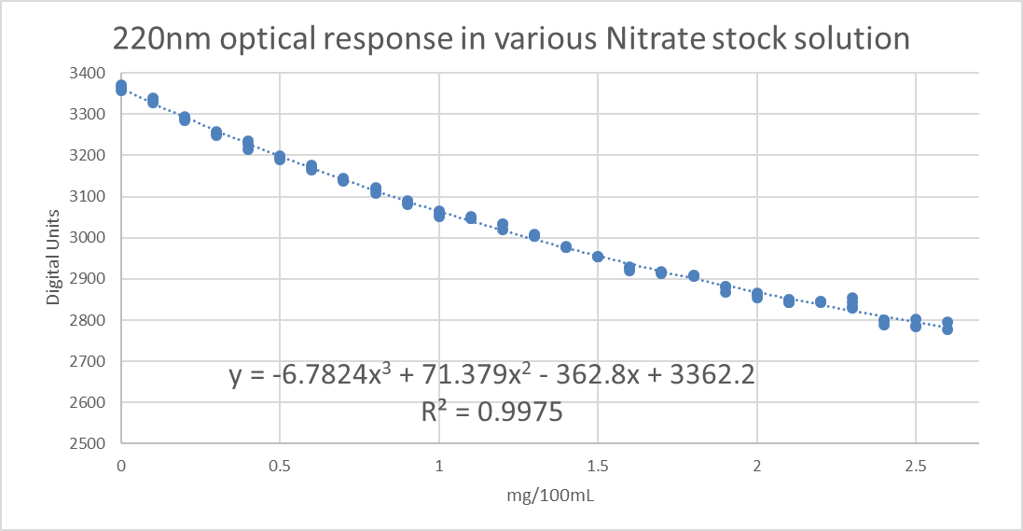
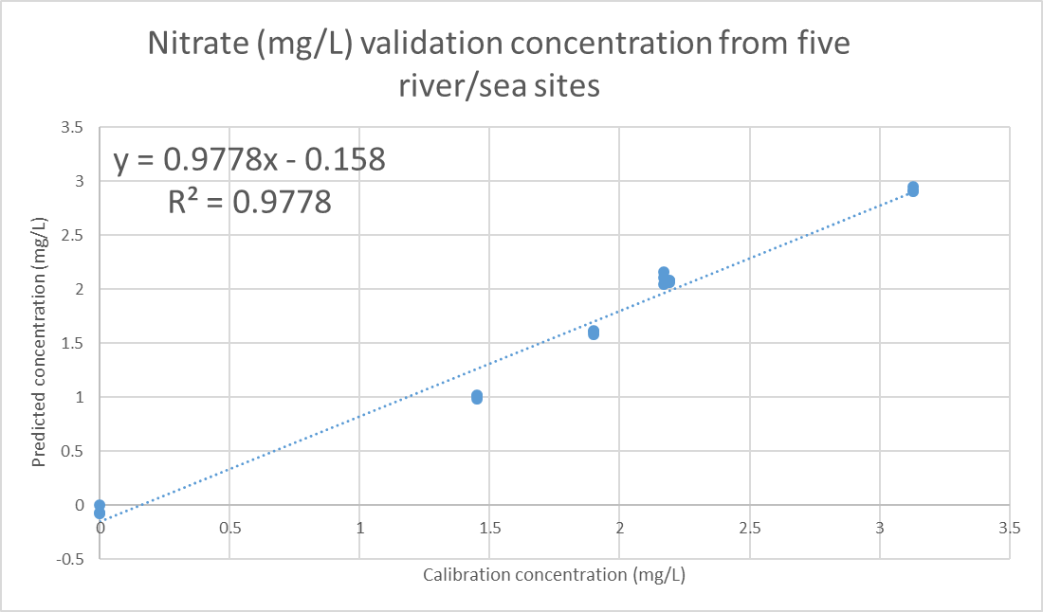
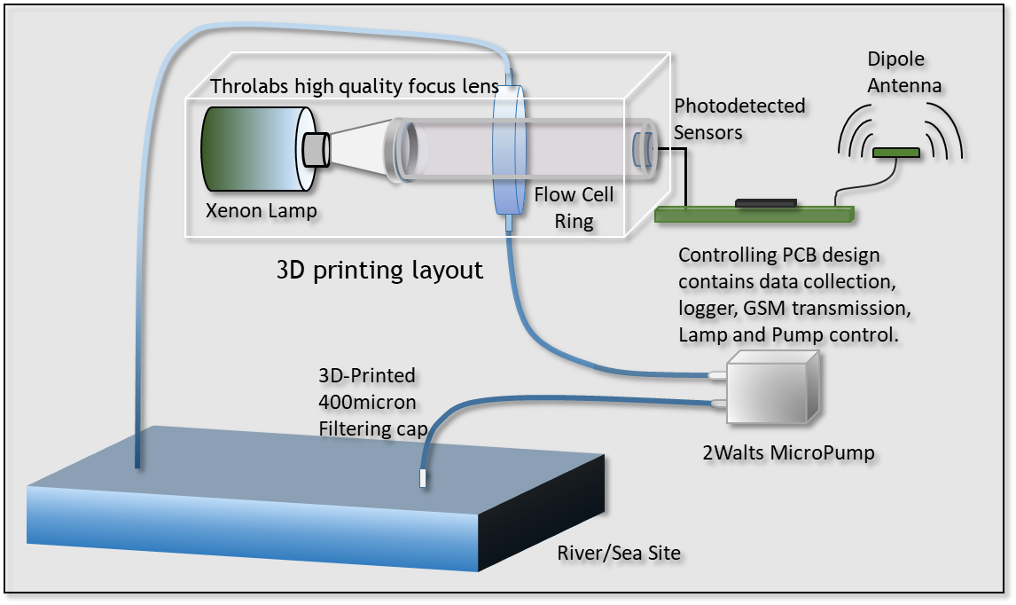
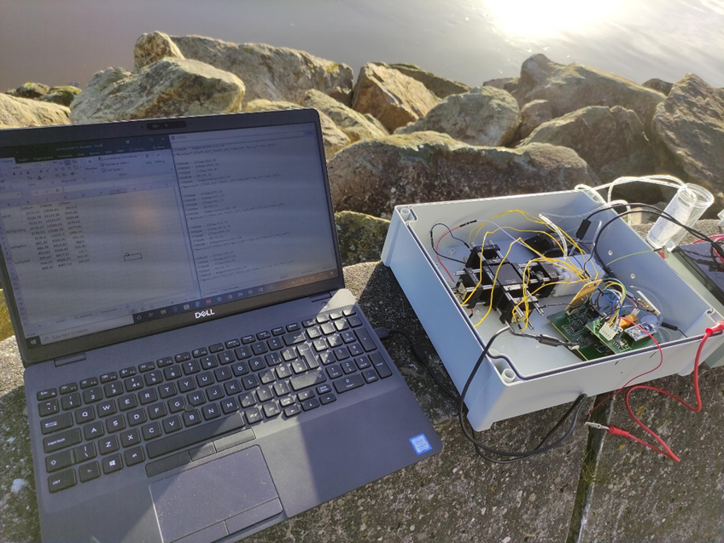
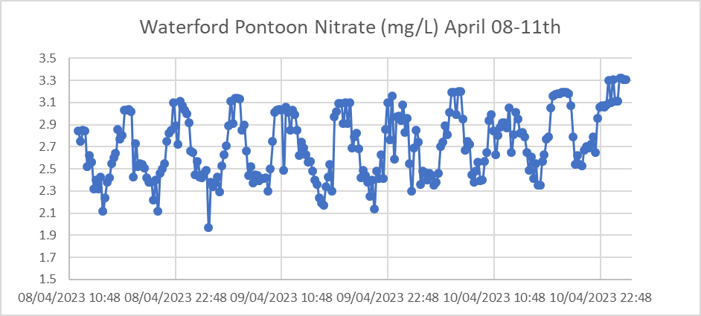
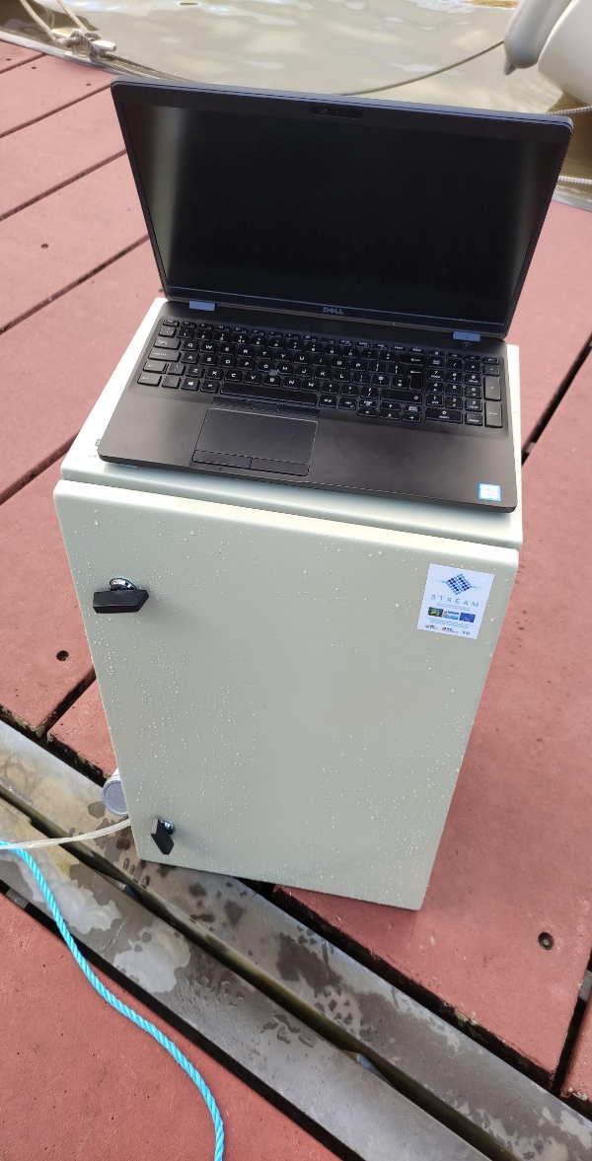
Sensor Technologies for
Remote Environmental Aquatic Monitoring
B Yu, J O’Mahoney, R Browne, J Ronan, M Abedini
South East Technological University, Waterford, Ireland
Introduction
The work described in this poster is on developing a relatively low-cost optical sensor system using multiple narrow spectra response photodiodes with a function for remote aquatic monitoring and live data transmission for assessing the qualities of marine waters. We have produced a cloud-connected Microelectromechanical System (MEMS) solution to determine Nitrate and Dissolved Organic Carbon (DOC) in estuarine waters. Prototype units have also been fabricated for field testing.
Optical Nutrient Sensor
Advances in MEMS technology, the series of UV photodiodes using an interference filter for its window and is sensitive only to monochromatic light at 220nm, 254nm, and 275nm FWHM narrow at 10nm for detecting the Nitrate and Dissolved Organic Carbon contents. These units offer good resolving power and sensitivity that have the potential to be deployed in marine environmental monitoring.
3D printing and Electronics Methodologies
Supported by Formlabs 3D printing technology, we can create specifically designed objects by manufacturing to a 50-micron level of precision. Once made, these objects can be used to hold and protect optical and electronic devices. The chart of the electronics circuit summarised the converting of light response into the electrical current so that analytical instruments can recognise and translate to values.
UV optical photodiodes flowing system
SLA 3D printed objects
SLA 3D printed objects
Mobile Network Cloud Platform
Smart cloud-compatible microcontrollers can effectively shift between wireless communication protocols incorporating programmable software changes. The data transmission is through GSM/3G/4G mobile network using MQTT protocol and database support from the Walton Institute, who also provide advanced server data storage and platform design techniques.
MQTT mobile network data transmission
Electronics design of Multi-Sensors for Aquatic monitoring system
MQTT mobile network data transmission
Algorithm Analysis
The objective of data analysis is to transform the information in order to identify the relationship between different groups of data. By using the Partial Least Squared Regression (PLSR) analysis, the Nitrate content calibration result above shows a high correlation between the light transmittance at 220nm wavelength and the concentration of Nitrate, and the correlation coefficient equation is created as a predictive model for field samples.
Nitrate standard solutions calibration for the 220nm response.
Nitrate standard solutions calibration for the 220nm response.
Nitrate sensor validation by sea water samples laboratory analysed results .
Optical System Layout
Nitrate sensor validation by sea water samples laboratory analysed results .
The developed system's principle mainly relies on a smart micro-pumping unit produced by Radionics (extension output control to a 5A higher power cylinder pumping unit) to collect water samples from the sites. This sample flows through a self-designed 3D-printed flow cell ring. The pumping unit and UV Xenon flash lamp are synchronised by the control of Arduino Nano/Nano every finger size microchip and signal transmission between the controlling board and GSM board. Figure 5 shows an early version of the optical system design.
Wexford harbour in-field testing
Optical nutrient system layout
Wexford harbour in-field testing
Conclusion and future work
Optical nutrient system layout
Five water samples were collected from five sites around Wexford and Waterford counties, and the STREAM-developed instrument's results were confirmed by accredited laboratory analysis in the validation results of a regression model. The prediction model for Nitrate and DOC provides an average R2 of 97.78% and 93.92% for the PLS2 model, respectively. With these results, the regression models of high prediction accuracies of nitrate and DOC contents converted from raw data can be achieved. The system has passed through the early stage of estuarine water tests at the Waterford City pontoon. The next phase of work will include sensor deployment at different sites for testing, data analysis and comparison with commercial sensor findings. pH/temperature, Voltage and power consumption sensors calibration and testing in higher saline waters, and keep optimising the whole system design.
72 hours on-site nitrate concentration estuarine test at Waterford river site
72 hours on-site nitrate concentration estuarine test at Waterford river site
References
Anthony, E. C., Peter, H. S., & Yvonne, C. (2001). Determination of Nitrate in Water Containing Dissolved Organic Carbon by Ultraviolet Spectroscopy. International Journal of Environmental Analytical Chemistry, 49-59.
Pierre, F., Gabriel , D., & Ricardo , R. (2022). Influence of the conservation mode of seawater for dissolved organic carbon analysis. Marine Environmental Research.
Wang, H., Ju, A., & Wang, L. (2021). Ultraviolet Spectroscopic Detection of Nitrate and Nitrite in Seawater Simultaneously Based on Partial Least Squares. Molecules, 3685.

